Slide 1

Topic: Mechanism of Process Execution
Lecture: Dr. Zhao Jie
Date: 02/02/2025

Slide 2
Reading Assignment
Reading Assignment: Ch. 6

Slide 3
Agenda
  Formation of a process from a program
  Direct execution
  Restrict execution
  System call execution
  Timer interruption

Slide 4
Formation of Process from Program - 1 [1]
For a program to become a process, it must go through various actions:
  Loading the program into memory.
  Allocating memory for the process (code, data, stack, heap).
  Creating a Process Control Block (PCB) to track the process.
  Initializing the CPU context (registers, stack pointer, program counter, etc.),
  Finally, putting the new process into the scheduler’s queue (transitioning it to the “ready” state, and eventually to “running”).
[1] Formation of Process from Program https://www.geeksforgeeks.org/operating-systems/formation-of-process-from-program/

Slide 5
Formation of Process from Program – 2 [1]
1. Program Loading (Loading the Executable into Memory):
  The first step is loading the program from disk into memory. The operating system’s loader is responsible for this. It locates the executable file on storage and reads its contents (the program’s machine code and static data) into memory.
  In this stage, the OS typically creates a new address space for the process and begins populating it with the program’s code (text segment) and initialized data.
  During this loading phase, the OS also prepares basic memory structures for the process’s runtime, such as setting up an initial stack and heap region for the process.
[1] Formation of Process from Program https://www.geeksforgeeks.org/operating-systems/formation-of-process-from-program/

Slide 6
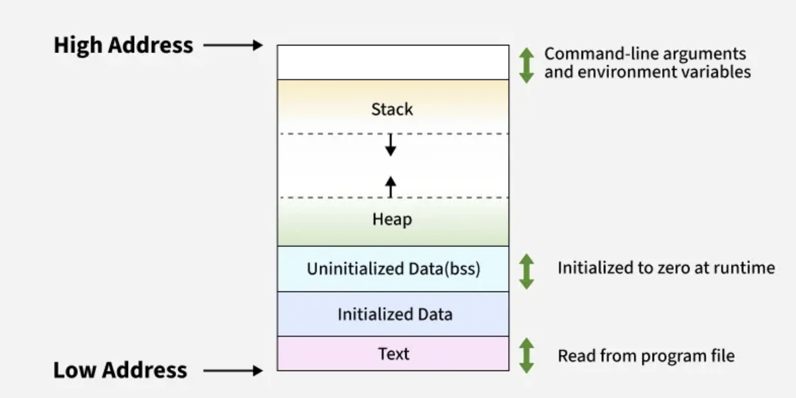
Formation of Process from Program – 3 [1]
2. Memory Allocation:
[1] Formation of Process from Program https://www.geeksforgeeks.org/operating-systems/formation-of-process-from-program/

Slide 7
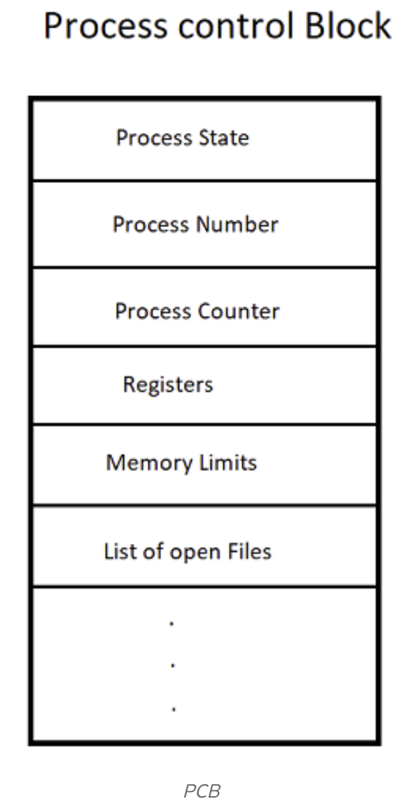
Formation of Process from Program – 4 [1]
3. Creating the Process Control Block (PCB):
  In parallel with establishing the memory, the OS creates a Process Control Block (PCB) for the new process. The PCB (sometimes called a process descriptor or task control block) is a data structure in the kernel that holds all the metadata about the process.
  When the process is created, the OS assigns it a unique Process Identifier (PID) and adds an entry for the process in the system’s process table (an index of all active processes). Memory for the PCB itself is allocated (often as part of the kernel’s process table or a separate kernel memory area).
[1] Formation of Process from Program https://www.geeksforgeeks.org/operating-systems/formation-of-process-from-program/

Slide 8
Formation of Process from Program – 5 [1]
4. Setting Up the Execution Context:
  Stack Initialization: The process’s stack region was allocated earlier; now the OS arranges the initial stack frame. This often includes placing the program’s command-line arguments and environment variables onto the stack or in a specific memory region, and setting the stack pointer accordingly.
  Heap Setup: The heap segment is typically empty at start (no allocations done yet), but the OS establishes a pointer (or break value) that indicates the current end of the heap. The OS ensures the process has the right to expand its heap up to some limit. In practice, nothing specific is placed in the heap at creation except setting its boundaries.
  CPU Registers and Execution Start: The OS initializes the CPU register context for the new process so that it can start execution. This includes setting the instruction pointer (program counter) to the program’s entry point. It also sets the stack pointer register to the top of the stack segment that was set up, and may set other registers. Essentially, the OS prepares a context such that if the CPU were to switch to this process, it would start executing the new program from its beginning with a clean stack.
  Kernel/Mode Context: The OS also sets up any needed kernel-mode context for the process. For example, it may allocate a kernel stack for the process/thread (used when the process transitions to kernel mode for system calls or interrupts).
[1] Formation of Process from Program https://www.geeksforgeeks.org/operating-systems/formation-of-process-from-program/

Slide 9
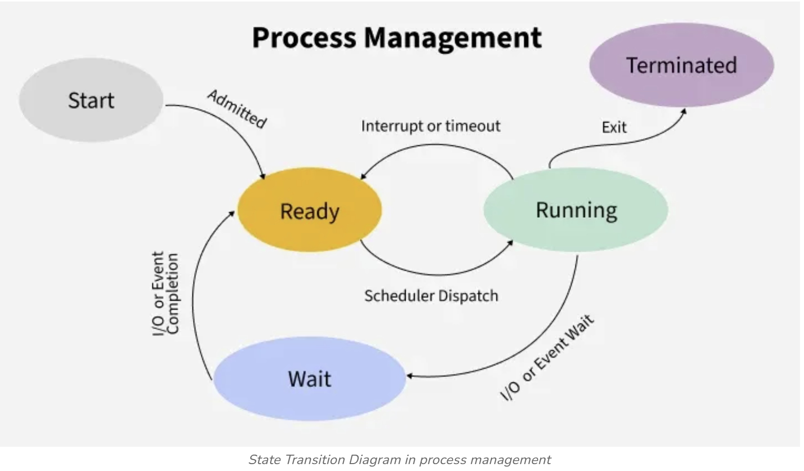
Formation of Process from Program – 6 [1]
5. Transition to Ready State and Scheduling:
[1] Formation of Process from Program https://www.geeksforgeeks.org/operating-systems/formation-of-process-from-program/

Slide 10
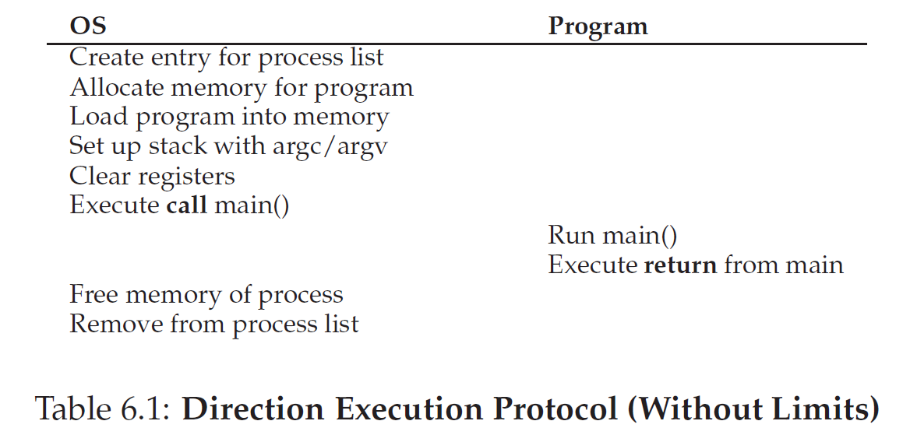
Direct execution
“Direct execution”: runs the program directly on the CPU
Time 1
Time 2
Time 3

Slide 11
Restricted executions
Problem from direct execution
  Might abuse CPU usage
  Cannot protect hardware like I/O requests.
User mode
  Restricted: Issuing I/O requests to the disk will cause an interruption
Kernel mode
  Higher privilege: enable to issue I/O requests to the disk

Slide 12
System call execution
Motivation
  If a user mode tends to access a disk for reading/ writing files, a system call is necessary.
System call execution
  Triggers the trap instruction and jumps into the kernel mode
  Do the required work for the calling process
  Calls a special return-from-trap instruction and back both called process and user mode

Slide 13
Specifications of system call execution
Trap instruction
  Jumps into the kernel and raises the privilege level to kernel mode
The return-from-trap instruction
  Returns into the calling user program while simultaneously reducing the privilege level back to user mode
Kernel stack
  where registers (including general-purpose registers and the program counter) are saved to and restored from(by the hardware)when transitioning into and out of the kernel
Trap table
  One of the first things the OS does is tell the hardware what code to run when certain exceptional events occur.

Slide 14
A trap example - a printf for printing to the monitor[1]
  1) User Program Execution
  Your program running in user mode encounters a printf statement that needs to display text on the screen.
  2) Trap Generation
  The printf statement triggers the execution of a system call instruction, which acts as a trap.
  3) Mode Switch
  The CPU detects this trap and switches from user mode (with limited privileges) to kernel mode (with full privileges)
  4) Kernel Mode Handling
  The operating system's trap handler takes over, processes the system call, and executes the necessary code to display the text on the monitor.
  5) Return to User Mode
  After the OS finishes its task, the trap handler returns control to the user program, and the CPU switches back to user mode, allowing the program to continue execution from where it left off.
[1]https://www.google.com/search?q=example+of+trap+in+os&rlz=1C1GCEA_enUS1156US1156&oq=example+of+trap+in+os&gs_lcrp=EgZjaHJvbWUyBggAEEUYOTIKCAEQABiABBiiBDIKCAIQABiABBiiBDIKCAMQABiABBiiBNIBBzgwM2owajeoAgCwAgA&sourceid=chrome&ie=UTF-8

Slide 15
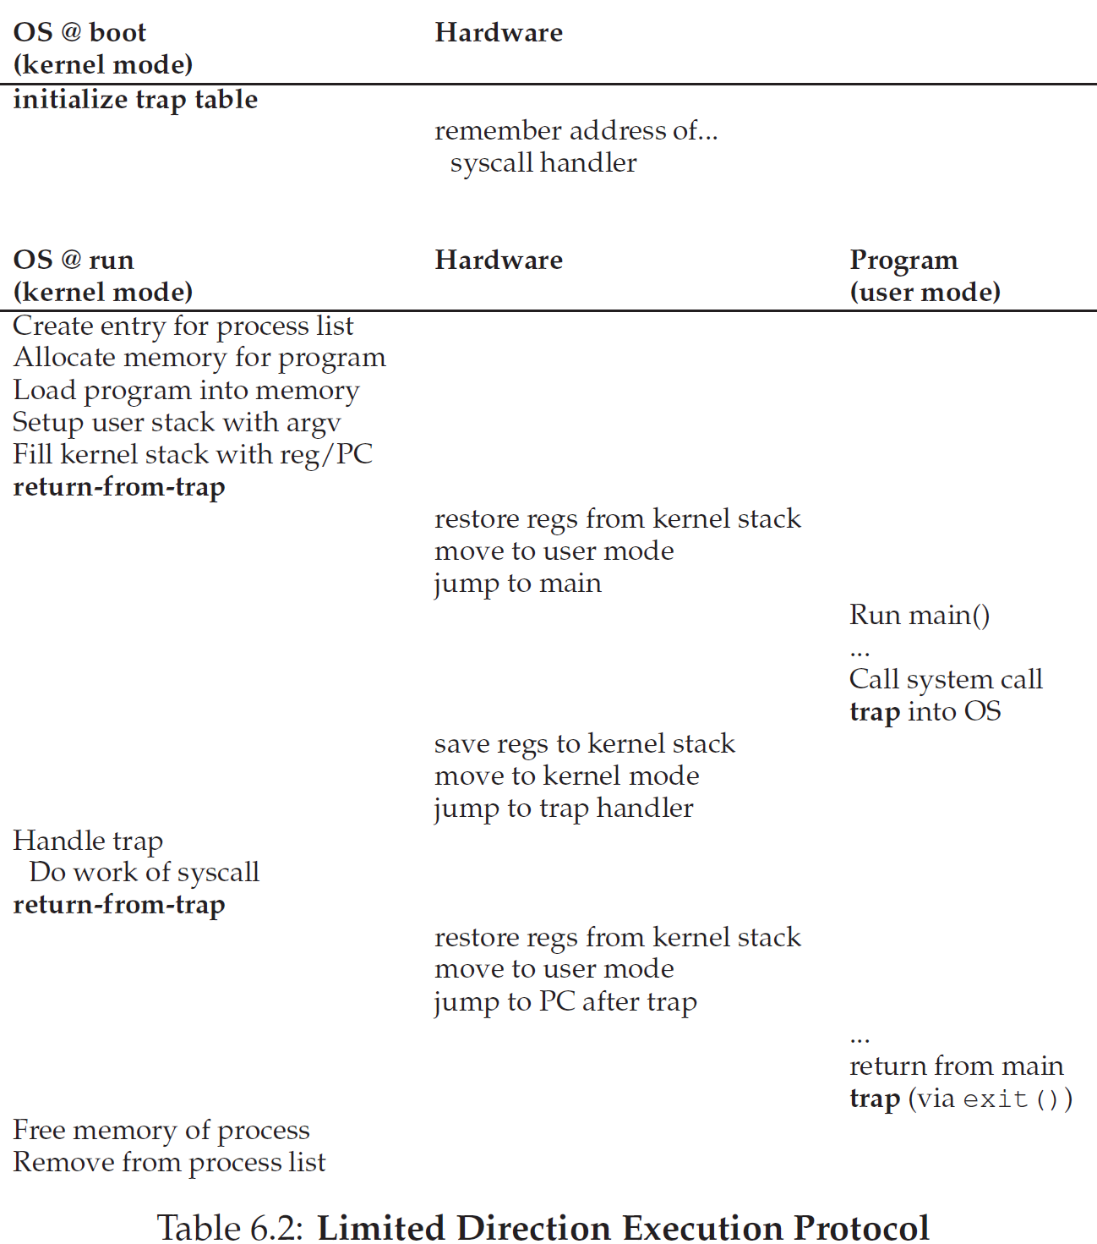
Trap table – monitoring system call execution
Phase 1
(Time 1)
Time 1
Time 2
Time 3
Time 4
Q1: Why is a trap set up at time 4?
Phase 2
(The rest)
Time 5
Time 6
Time 7
Time 8
Q2: Why is a trap set up at time 8?
Time 9
Notes:
Q1: The fork() could be called at time 4.
Q2: The exit() is called at time 8.

Slide 16
Switch between processes
A Cooperative (Non-Preemptive) Approach: Wait For System Calls
  Processes that run for too long are assumed to periodically give up the CPU so that the OS can decide to run some other task.
  If the process runs illegally, like zero division calculation, OS will call the trap to regain control of the CPU.
A Non-Cooperative(Preemptive) Approach: The OS Takes Control by time interrupt
  First, the OS must inform the hardware of which code to run when the timer interrupt occurs.
  Second, the OS must start the timer and take the CPU control to the user program.
  The hardware saves the states of the program for a subsequent return-from-trap instruction.

Slide 17
Saving and Restoring Context
Scheduler
  The OS decides whether to continue running the currently-running process, or switch to a different one.
Context switch
  All the OS has to do is save a few register values for the currently-executing process (onto its kernel stack, for example) and restore a few for the soon-to-be-executing process (from its kernel stack).

Slide 18
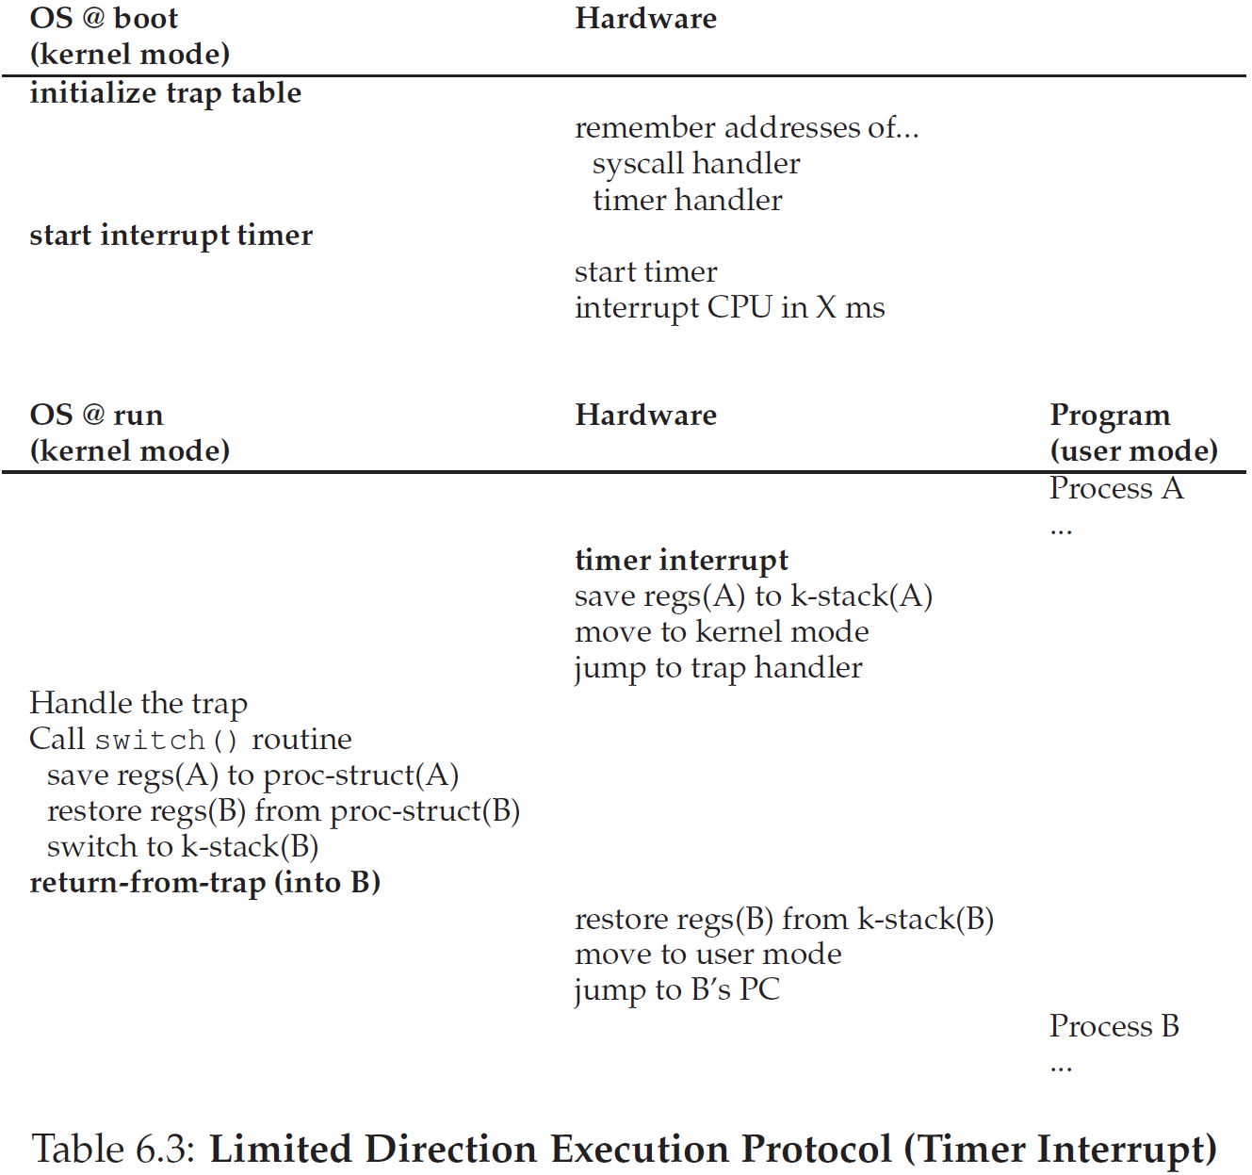
Trap table – processes switch
Time 1
Time 2
Q1: What’s the diff from without Time Interrupt in Table 6.2?
Time 3
Time 4
Time 5
Notes:
Q1: There are two programs. To make two programs run efficiently, a time interruption is necessary.

